Slide 1
Catering reservation and ordering system
Made By: Sneha Agrawal

Slide 2
Objective:
The main objective of catering management is to develop a software system for hotels that maintains the accounts which include the user can register, log in, browse through different pages, and have the features like scheduling a reservation, caterer registration, event name, order details, received orders reports

Slide 3
Benefits:
It saves time.
It keeps your cost down.
It creates a better customer experience.
It allows your business to go mobile.
It stores your data.

Slide 4
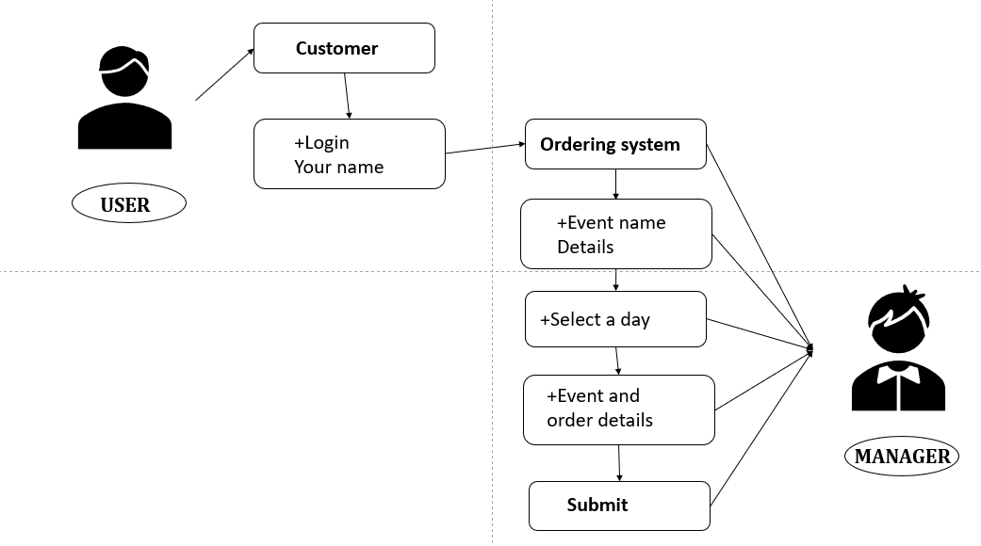
Architecture:

Slide 5
Customer login
User: After opening the site. Firstly, customers fill out their details.
Then they go to the next option, Event name, where they exactly have to put what event is going to be.
After naming the event name, they can select the day and date when the event is going to happen.
Then they can put their order details in that so that the manager can understand what dishes they want in the event.

Slide 6
Ordering SYSTEM
Then they can submit all the details.
After submitting these details goes to the manager so that he/she can verify all the details given by customer and confirm the order of the event.

Slide 7
THANKYOU

